Slide 1
Final Year Project Wanying(Ivy) Xue C13491872

Slide 2
Project - Paradis de la beauté
Create a social networking web application for the beauty/fashion industry where beauty/fashion bloggers can post and connect with followers.
Have one place where beauty/fashion/travel bloggers can review the products they have bought and share their travel tips.
Where users can follow these bloggers and these bloggers can promote products they have used.
Users can view product reviews and add their own review of a product.

Slide 3
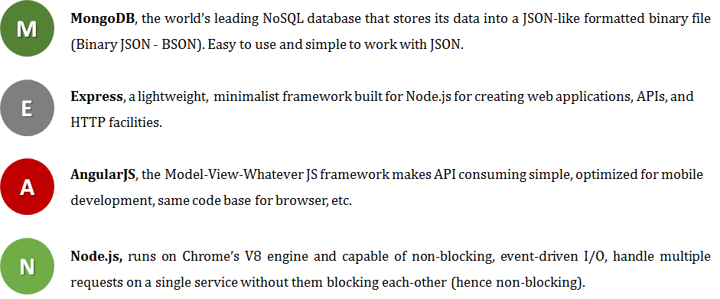
Technologies Used MEANSTACK
Full-stack, JavaScript solution
Accelerates building fast, robust, and maintainable web applications
Using MongoDB, Express, AngularJS, and Node.js technology stack.

Slide 4
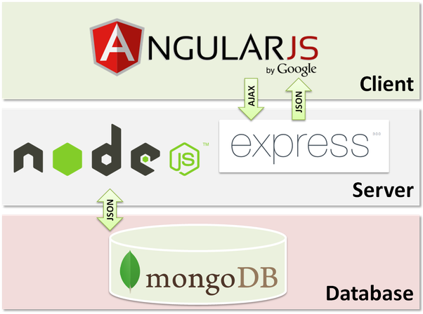
MEANSTACK CONCEPT
1. Client make request
2. Node.js parse request
3. Express.js gets request and send it to the database
4. MongoDB retrieves data
5. Express.js return response
6. Angular.js display request

Slide 5
Other Technologies Used
Stripe
JWT(JSON Web Token) for authentication
NPM for Adapt packages of code to my apps
Multer for file upload
Mongoose serve as data persistent API
Bootstrap,CSS
Google Chart API

Slide 6

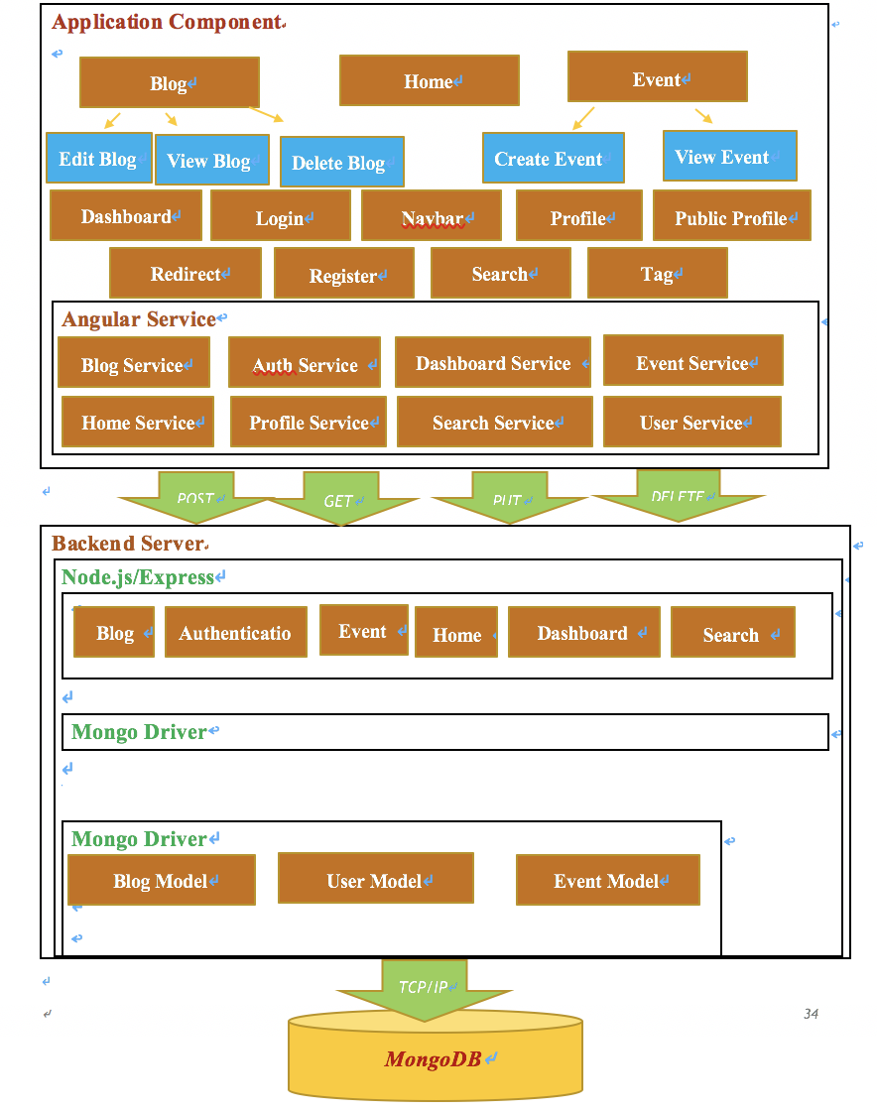



System Architecture

Slide 7
Thank You For your time
Any Questions?

